Slide 1
ASYNCHRONOUS PROGRAMMING. PART 1
By Mykhailo Torskyi

Slide 2
EVENT LOOP
The event loop got its name because of how it's usually implemented, which usually resembles:
while (queue.waitForMessage()) {
queue.processNextMessage()
}
queue.waitForMessage() waits synchronously for a message to arrive (if one is not already available and waiting to be handled)

Slide 3
const foo = () => console.log("First");
const bar = () => setTimeout(() => console.log("Second"), 500);
const baz = () => console.log("Third");
bar();
foo();
baz();

Slide 4
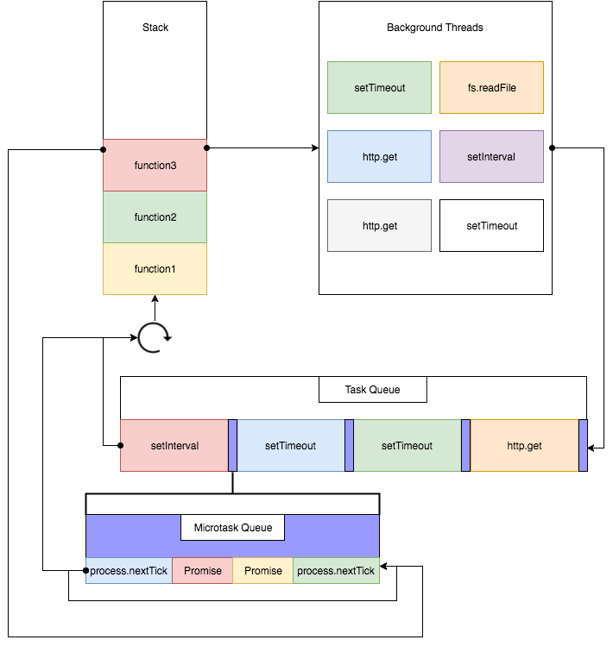

Slide 5
Javascript is a single threaded language. This means it has one call stack and one memory heap. As expected, it executes code in order and must finish executing a piece code before moving onto the next.

Slide 6
CONCURRENCY MODEL
Concurrency becomes very important when we are dealing with anything that is considered a synchronous activity — a type of activity where the main actor (user, CPU, etc) needs to stop and wait for another activity to be completed

Slide 7
How programs actually implement concurrency?
Blocking pattern
Non-blocking pattern

Slide 8
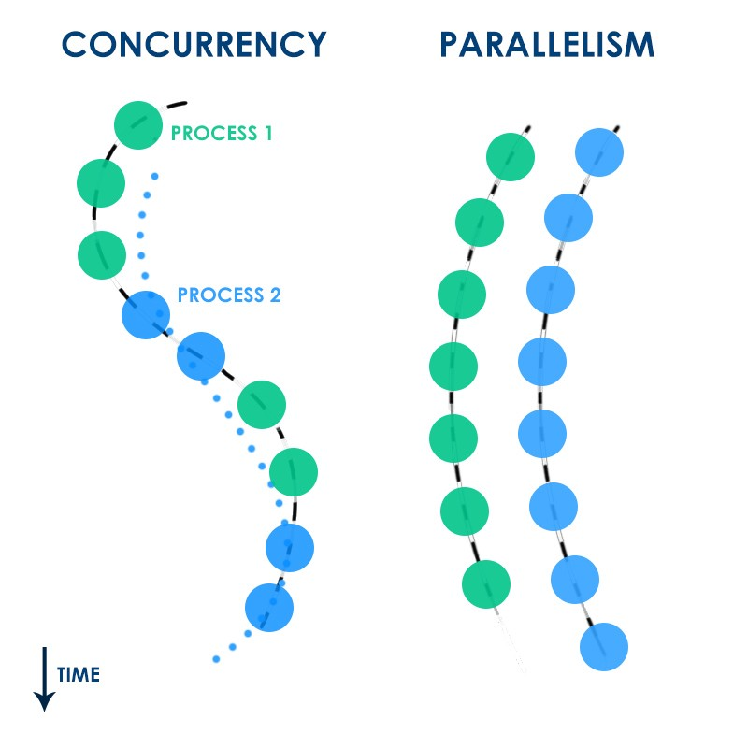

Slide 9
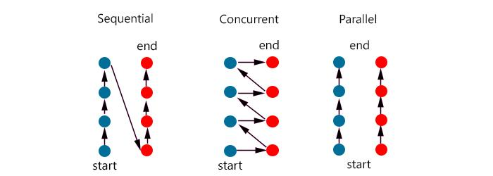

Slide 10
USEFUL LINKS
https://blog.vanila.io/handling-concurrency-with-async-await-in-javascript-8ec2e185f9b4
https://developer.mozilla.org/uk/docs/Web/JavaScript/Reference/Global_Objects/Promise
https://www.youtube.com/watch?v=8aGhZQkoFbQ

Slide 11


